Slide 1

ANNAMACHARYA INSTITUTE OF TECHNOLOGY AND SCIENCES::TIRUPATI (AUTONOMOUS) DEPARTMENT OF ARTIFICIAL INTELLIGENCE A.Y.: 2024-2025 FINAL REVIEW [Academic year: 2024-25 * Batch: 2021-25]
Under the Guidance of
Mrs K.Jagadeeswari, M.Tech., (Ph.D)
Assistant Professor
Department of AI
AITS, Tirupati.
Head of the Department
Dr. C.Siva Balaji Yadav, M.Tech., Ph.D
Associate Professor
Department of AI
AITS, Tirupati

Slide 2
PROJECT TITLE
Image Forgery detection using MD5 and openCV
AIDS-1- BATCH NO: 04
21AK1A3033 P.LAKSHMI PRIYANKA
21AK1A3017 V. GANESH
21AK1A3051 M.NAYUM BASHA
21AK1A3037 B.MAMATHA

Slide 3
ABSTRACT
Because cameras are so widely accessible, taking pictures has grown in popularity recently. Photos are crucial to our everyday lives since they are replete with information, and it is sometimes necessary to improve images in order to get more information. Although there are many technologies available to enhance picture quality, they are also regularly used to alter photos, which leads to the dissemination of false information. This makes picture forgeries more severe and frequent, which is now a major cause of worry. To identify fake images, several conventional methods have been developed over time. openCV have drawn a lot of interest in recent years, and they have also had an impact on the area of picture fraud detection. However, the majority of openCV-based picture forgery detection methods currently used in the literature are restricted to identifying a certain kind of fraud (either image splicing or copy-move). Therefore, it is necessary to develop a method that can quickly and precisely identify any hidden forgeries in an image. In the context of double image compression, we describe in this study a robust deep learning-based approach for detecting picture forgeries.

Slide 4
DOMAIN INTRODUCTION
Image forgery involves manipulation techniques like splicing, cloning, and retouching to alter the content of digital images.
Detecting forgeries is crucial in fields such as journalism, law enforcement, and digital security to ensure authenticity and reliability.
OpenCV provides essential tools for image processing, feature extraction, and pattern recognition, aiding in the detection of forged regions.
MD5 hashing generates unique hash values for images, allowing comparison and detection of tampering through hash mismatches.
Common detection techniques include error level analysis, pixel-level feature analysis, and identifying inconsistencies in image artifacts.
Applications range from verifying digital evidence to authenticating social media content and combating misinformation.
Challenges in this domain include detecting forgeries in low-resolution images, addressing advanced editing techniques, and countering adversarial manipulations.

Slide 5
EXISTING SYSTEM
In early days, to detect the forgery of images is a complex thing. It requires more manual power and it’s a time taking process. There is no accurate detection techniques.
DISADVANTAGES OF EXISTING SYSTEM
Time taking
Low accuracy
High computational cost
Lack of Robustness
Inability to Handle Advanced Forgery Techniques

Slide 6
PROPOSED SYSTEM
In this proposed method, we are using deep learning methods to detect the image forgery. We can detect the image forgery with high accuracy by using openCV and MD5 methods. MD5 gives the better performance in image detection.
ADVANTAGES OF PROPOSED SYSTEM
Requires less time
High accuracy
Better adaptability
Efficient and Scalable
Robust forgery detection

Slide 7
LITERATURE SURVEY
S. No | Title of the Paper | Problem Statement | Method/ Algorithm Used | YEAR | AUTHOR NAMES
1. | Image splicing forgery detection combining coarse to refined convolutional neural network and adaptive clustering | This paper proposes a splicing forgery detection method with two parts: a coarse-to-refined convolutional neural network (C2RNet) and diluted adaptive clustering | Coarse-to-Refined Convolutional Neural Network (CNN), Adaptive Clustering | 2020 (Journal) | Xiao, B.; Wei, Y.; Bi, X.; Li, W.; Ma, J
2. | CAT-Net: Compression Artifact Tracing Network for Detection and Localization of Image Splicing | Detecting and localizing image splicing has become essential to fight against malicious forgery | CNN, Autoencoders, Feature fusion | 2021 (WACV) | M.J.; Yu, I.J.; Nam, S.H

Slide 8
S.No | Title of the Paper | Problem Statement | Method/ Algorithm Used | YEAR | AUTHOR NAMES
3. | ManTra-Net: Manipulation Tracing Network for Detection and Localization of Image Forgeries With Anomalous Features | To fight against real-life image forgery, which commonly involves different types and combined manipulations | CNN, Anomaly Detection, Pixel-wise Classification | 2019 (CVPR) | Wu, Y.; Abd Almageed, W.; Natarajan, P
4. | A survey on image tampering and its detection in real-world photos | This survey provides an overview on typical image tampering types, released image tampering datasets and recent tampering detection approaches | Signal Processing Methods, Image Cloning and Morphing Detection | 2019 (Journal) | Zheng, L.; Zhang, Y.; Thing, V.L

Slide 9
MINIMUM SYSTEM REQUIREMENTS
Software Requirements:
Operating System : Windows 10
Server-side Script : Python 3.6
IDE : VS code
Libraries Used : Numpy, IO, OS, Keras, pandas, tensorflow,Opencv
Hardware Requirements:
Processor : I5/Intel Processor
RAM : 8GB (min)
Hard Disk : 128 GB

Slide 10
ANALYSIS AND DESIGN

Slide 11
Analysis
System and User Modules
User:
Data gathering:
Needs to gather the information or data from the open source, this will be use in the train the models.
Pre-processing:
Data need to be pre-processed according the models it helps to increase the accuracy of the model and better information about the data.
Feature Engineering:
In this step features are selected based on the priority of the column data, by this we can reduce the time investing on many columns.

Slide 12
Model Building
To get the final result model building for the dataset is an important step. Based on the dataset we build the model for classification and regression.
View Results
User view’s the generated results from the model.
System:
Model Checking
System checks model accuracy and it takes of the necessary for the model building
Generate Results
System takes the input data from the users and produces the output

Slide 13
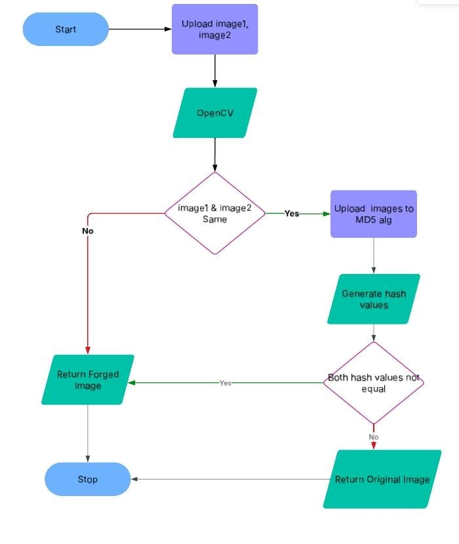
DESIGN
Data Flow Diagram

Slide 14
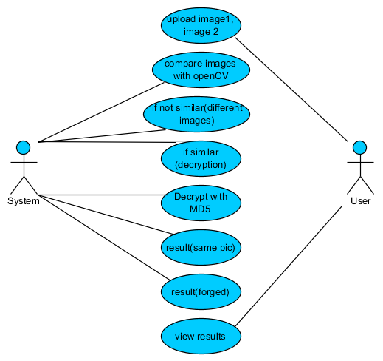
UML DIAGRAMS
USE CASE DIAGRAM

Slide 15
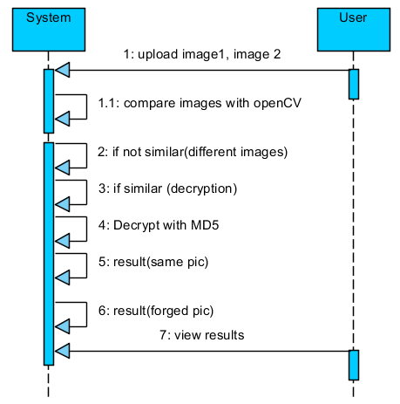
SEQUENCE DIAGRAM

Slide 16
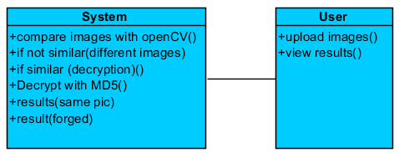
CLASS DIAGRAM

Slide 17
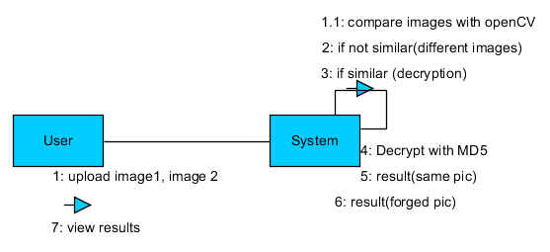
COLLABORATION DIAGRAM

Slide 18
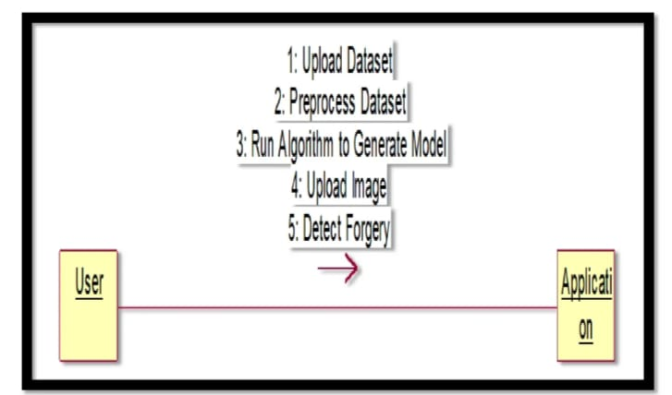
DEPLOYMENT DIAGRAM

Slide 19
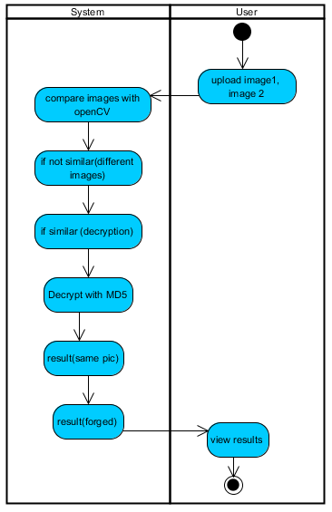
ACTIVITY DIAGRAM

Slide 20
IMPLEMENTATION, TESTING & RESULTS

Slide 21
OpenCV:
Working Process:
Read the Image: Load the image using OpenCV (cv2.imread()).
Convert to Grayscale: Convert the image to grayscale for better processing.
Edge Detection: Use Canny edge detection to highlight important features.
Feature Extraction:
Detect keypoints and extract features using SIFT or ORB.
These features help in identifying tampered areas.
Feature Matching:
Compare the input image with another image using FLANN or Brute-Force Matcher.
If there are differences in keypoints, the image is forged.
Output:
If tampering is detected, the system highlights forged regions using bounding boxes.
Keypoints are displayed to show differences between original and manipulated images.
Training:
Different types of forged images (copy-move, splicing, etc.) are used for testing.
OpenCV feature extraction methods are adjusted to improve detection accuracy.
Threshold values in feature matching are fine-tuned to reduce false detections.

Slide 22
MD5 Hashing:
Working Process:
Read and Convert Image: Convert the image into a byte format.
Generate MD5 If two imaHash:
Compute an MD5 hash to create a unique fingerprint of the image.
Compare Hashes:
ges have the same hash, they are duplicates.
If the hash is different, the image is unique or has been altered.
Output:
If the MD5 hash matches, the image is marked as duplicate.
If the MD5 hash differs, the image is either unique or tampered.
Training:
A dataset of duplicate and unique images is used for evaluation.
Different hashing methods (MD5, SHA-256) are tested for reliability.
The system is optimized to reduce hash collisions and improve accuracy.

Slide 23
TESTING
Integration Testing:
Integration testing ensures that different components of the image forgery detection system work together correctly. It verifies that OpenCV-based feature matching and MD5 hash comparison integrate seamlessly. This step ensures that forged and duplicate images are correctly identified.
Functional Testing:
Functional tests verify that the system detects forged and duplicate images accurately based on histogram comparison and MD5 hashing.
Functional testing is centered on the following items:
Valid Input: Two sample images (image1.jpg and image2.jpg) are provided for testing.
Invalid Input: If an unsupported image format or corrupted file is provided, the system should reject it.
Functions: The similar() function (histogram comparison) and createHash() function (MD5 hashing) must be executed correctly.

Slide 24
Output:
The system should correctly classify whether the images are duplicate, forged, or unique.
If images have identical MD5 hashes, they are marked as duplicates.
If histograms show significant differences, the image is flagged as forged.
Testing Objectives:
Duplicate Image Detection
Edited Image Detection
System Performance Testing
User Interface Testing
Integration Testing
Testing Features:
Exact Duplicate Detection
Similar Image Detection
Similarity Score Calculation
Multiple Image Format Support
User-Friendly Web Interface
Error Handling Mechanism
Efficient Image Processing

Slide 25
Systems/Procedures
The similar() function compares image histograms to detect visual differences.
The createHash() function generates and compares MD5 hashes for duplicate detection.
Unit Testing
Unit testing validates the individual functions in the system:
similar() function: Ensures histogram comparison works correctly and provides accurate similarity scores.
createHash() function: Verifies that MD5 hashes are generated consistently and detect duplicates correctly.
White Box Testing
White box testing checks the internal logic of the similar() and createHash() functions, ensuring:
Correct calculation of histogram differences.
Proper hashing of images without errors.
Logical flow for identifying forged or duplicate images.
Black Box Testing
Black box testing evaluates the system without knowledge of the internal code, focusing on:
Providing different image pairs and verifying correct classification.
Checking how the system handles edge cases, such as near-duplicate images.

Slide 26


RESULTS
Original Image:
Forged Image:

Slide 27

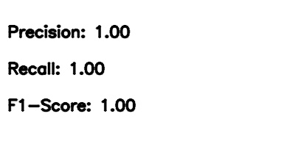
Comparing Hash Values:

Slide 28
COMPUTATIONAL METRICS:
Precision = TP / (TP + FP)
Recall = TP / (TP + FN)
F1-Score = 2 × (Precision × Recall) / (Precision + Recall)
Here, we have perfect detection, so:
True Positives (TP) = All forged pixels detected correctly
False Positives (FP) = 0 (No extra detections)
False Negatives (FN) = 0 (No missing forgery pixels)

Slide 29
Conclusion
The project has concluded that, we have developed an application by using deep learning methods to detect the image forgery. We can detect the image forgery with high accuracy by using OpenCV and MD5 methods. MD5 gives the better performance in image detection.
This project demonstrates a simple yet effective approach to detect forged images.
By combining histogram comparison and MD5 hashing, we can:
- Identify exact duplicate images
- Detect visually similar forgeries
However, advanced forgery techniques require AI-based solutions.

Slide 30
REFERENCES
Xiao, B.; Wei, Y.; Bi, X.; Li, W.; Ma, J. Image splicing forgery detection combining coarse to refined convolutional neural network and adaptive clustering. Inf. Sci. 2020, 511, 172–191.
Kwon, M.J.; Yu, I.J.; Nam, S.H.; Lee, H.K. CAT-Net: Compression Artifact Tracing Network for Detection and Localization of Image Splicing. In Proceedings of the 2021 IEEE Winter Conference on Applications of Computer Vision (WACV), Waikoloa, HI, USA, 5–9 January 2021; pp. 375–384.
Wu, Y.; Abd Almageed, W.; Natarajan, P. ManTra-Net: Manipulation Tracing Network for Detection and Localization of Image Forgeries With Anomalous Features. In Proceedings of the 2019 IEEE/CVF Conference on Computer Vision and Pattern Recognition (CVPR), Long Beach, CA, USA, 15–20 June 2019; pp. 9535–9544.
Zheng, L.; Zhang, Y.; Thing, V.L. A survey on image tampering and its detection in real-world photos. J. Vis. Commun. Image Represent. 2019, 58, 380–399.

Slide 31
Thank You!
Any Questions?

